Slide 1
Bob Duglin
Vice President, Business Development Meetings & Events
ASTA Destination Expo
Athens, Greece
April 14-17, 2018
Notes:
All small supplier who want to know about ASTA – this is a work shop about doing businesses in the travel agent channel
101 for travel supplier
Workshop
How to get your product sold by a professional travel advisor
Expanding your sell force

Slide 2
Selling YOUR product through the ASTA Destination Expo in Athens
Your chance to meet hundreds of US sellers of travel face-to-face

Slide 3
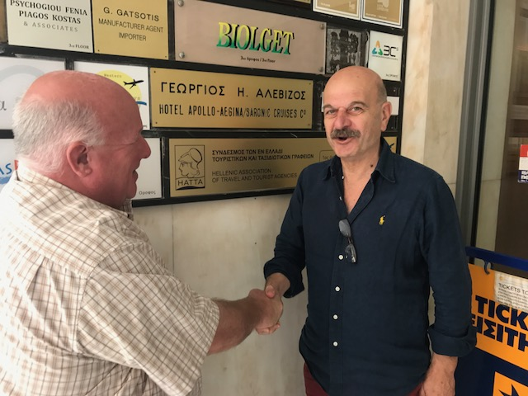
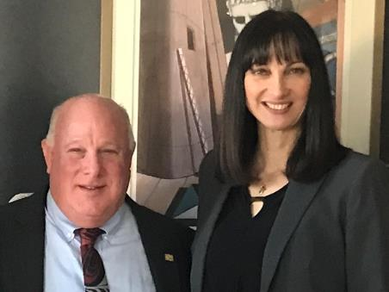
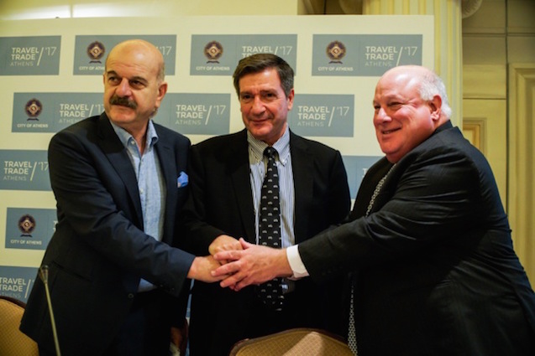
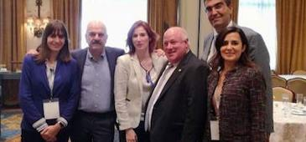
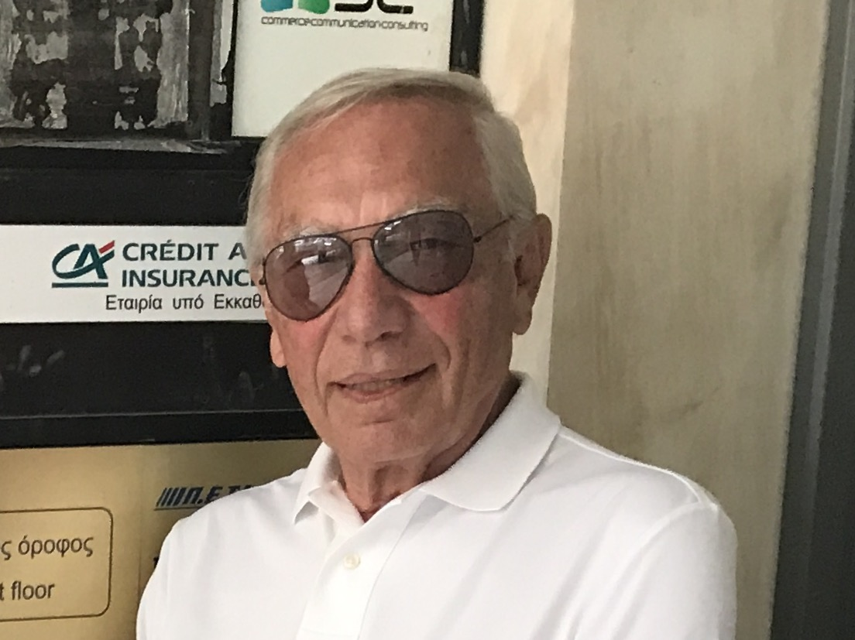
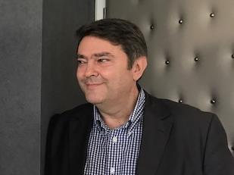
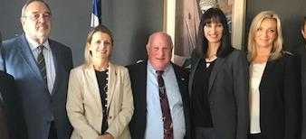
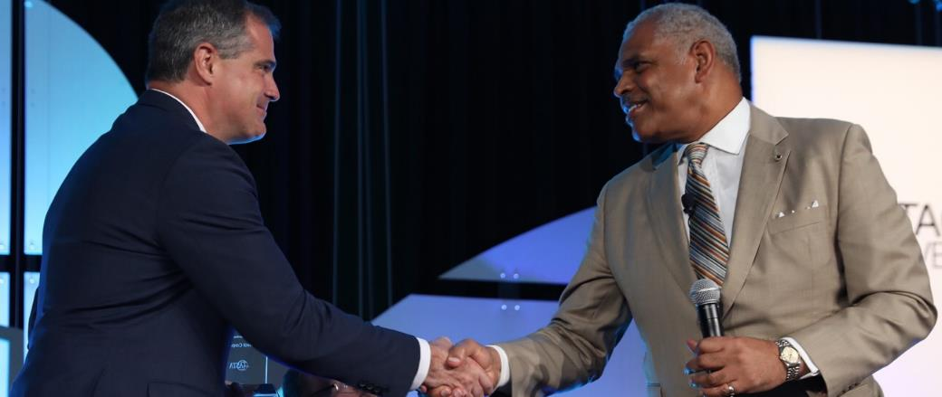
ASTA fedHATTA Friends

Slide 4
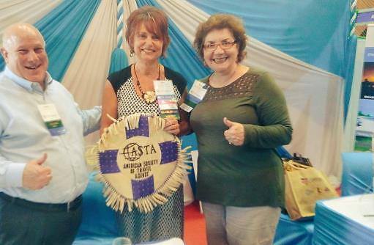
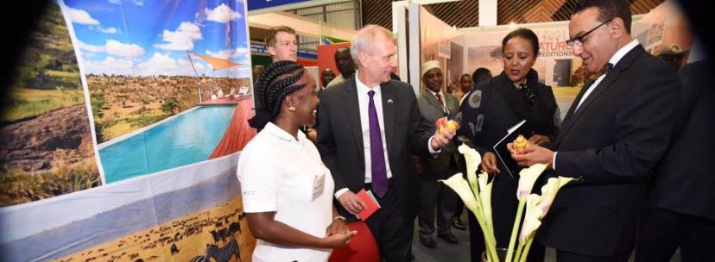
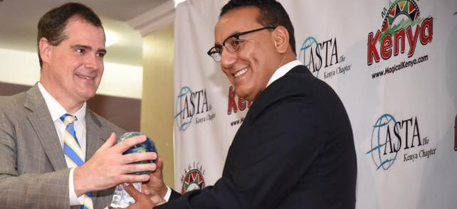
ASTA Destination Expo Nairobi, Kenya – Feb 2017
Notes:
I want to share with you how this conference came to be ….sitting one night sitting at my table with my friend Michael who connected to me with David Kasser.
! Ann, personal experience in this industry – my story, love this destinations, all the connections I have… my membership wants to know you

Slide 5
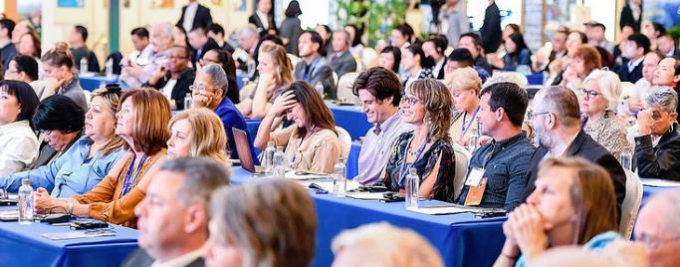
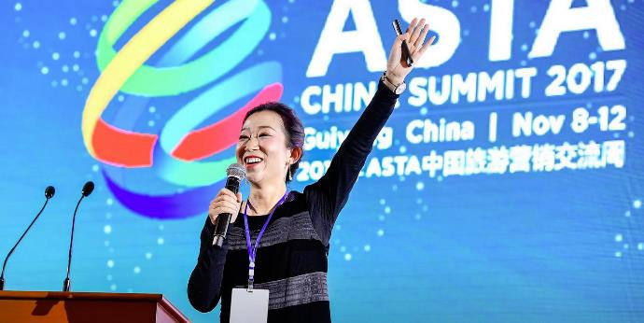
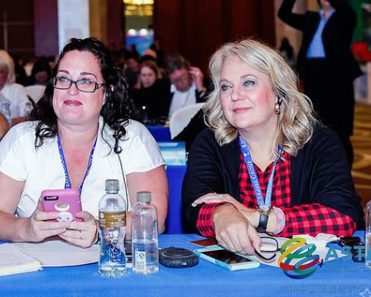
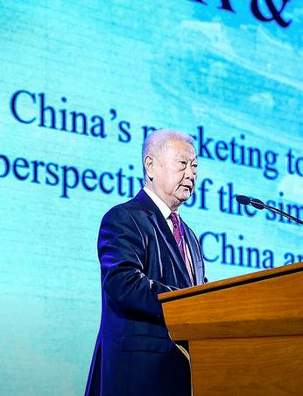
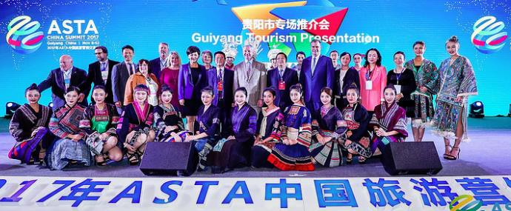
ASTA China Summit Guiyang, China – Nov 2017
Notes:
I want to share with you how this conference came to be ….sitting one night sitting at my table with my friend Michael who connected to me with David Kasser.
! Ann, personal experience in this industry – my story, love this destinations, all the connections I have… my membership wants to know you

Slide 6
ASTA Destination Expos
2017 Nairobi, Kenya
2016 Seville, Spain
2015 Marrakech, Morocco
2014 Merida, Mexico
2013 Dubai, United Arab Emirates
2012 Lima, Peru
2011 San Juan, Puerto Rico
2010 Istanbul, Turkey
2009 Sun City, South Africa
2008 Lyon, France
2007 JeJu Island, Korea
2006 Prague, Czech Republic

Slide 7
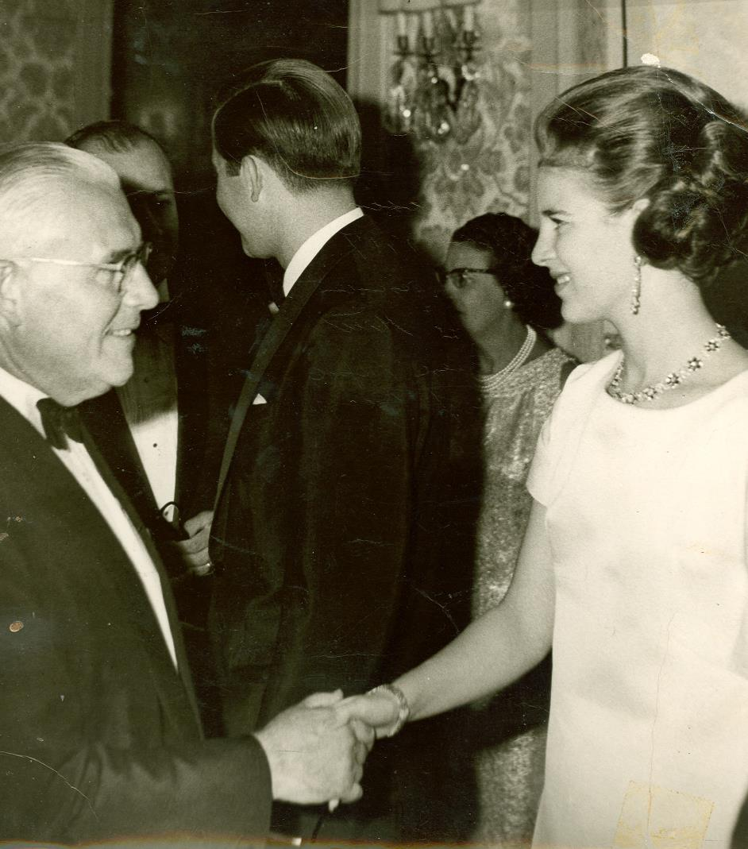
1967 - Athens ASTA World Congress
Athens hosted ASTA’s 37th Annual World Travel Congress, Oct 22-28
Dr Timothy O’Driscoll, president of the European Travel Commission with the keynote speaker
King Constantine & Queen Anne-Marie of Greece participated in the open session
Major increase of travel from the US to Greece commended as a result

Slide 8
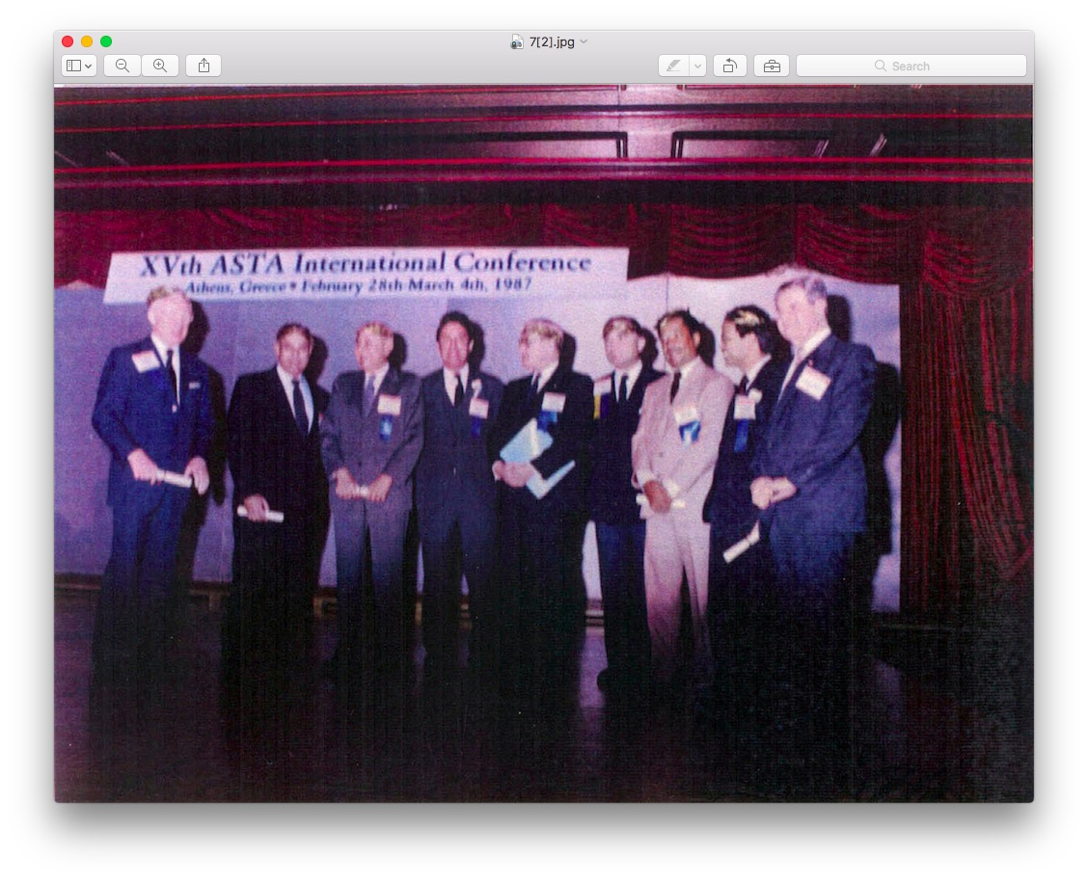
1987 - Athens ASTA World Congress
Athens hosted ASTA’s 1987 World Congress
ASTA intervention caused lifting of travel warning to Greece
US travel to Greece doubled in the year following the 1987 World Congress
Largest ASTA World Congress attendance vs previous years

Slide 9
Agenda
Who is ASTA?
Who is NACTA?
Industry Overview
Education
Travel Agent Access
Connecting to Travel Sellers
How You Benefit
Notes:
Replace BCD with the Alaska graphics on all slide
Pam has a slide – bar graphic of the full industry and who is in the industry.
20,000 IC
15,000 agency
Ann has asked for this from Pam already
VTA program
List of the program lists
Written handbook
and fam trips
In the fields --- field work in a destination
Make this two slides maybe
The industry counts
Travel agent access is our conference and events –
Connecting with travel sellers – Fams trips, all different levels of the

Slide 10
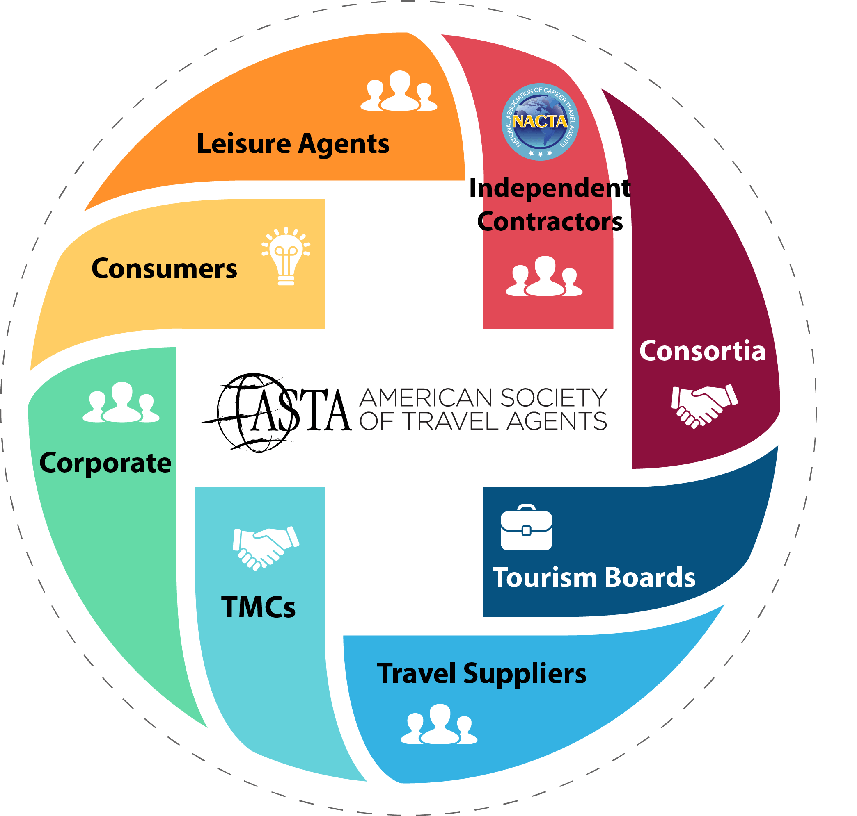
Who Does ASTA Represent
8,944 ASTA Members from
3,586 companies or agencies
80+%
of all travel booked through agency distribution channels is booked by ASTA agents

Slide 11
Who Does ASTA Represent
8,944 ASTA Members from
3,586 companies or agencies
80+%
of all travel booked through agency distribution channels is booked by ASTA agents

Slide 12
Who Does NACTA Represent
1,800 Members
Travel Consultants
Host Agencies
Suppliers
Notes:
In terms of NACTA members’ business models, the largest share is Hosted Independent (with members’ own business names working through a host agency), accounting for about half of NACTA membership (48%), followed by one third of NACTA members being Fully Independent (no hosts, direct deals with suppliers).
Less than one in ten (8%) members are franchise or host branded (business name is based on host agency or franchise) and just 6% survey respondents indicated that they are employees of other agencies.

Slide 13
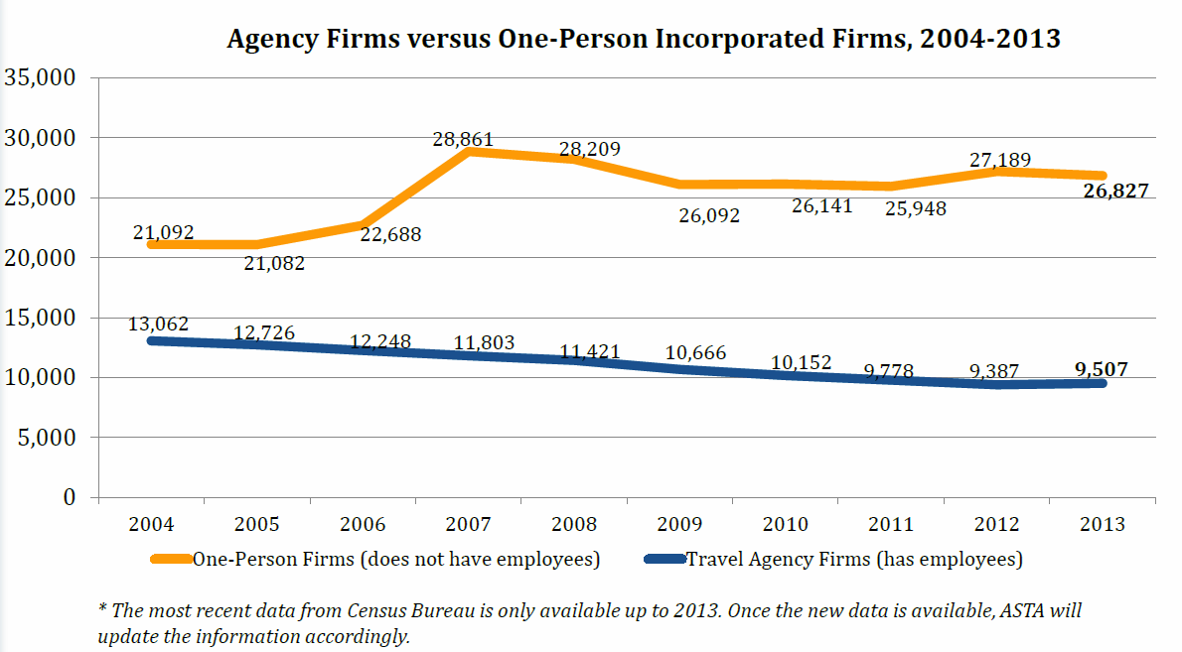
Notes:
According Census Bureau, there were 9,507 travel agency firms with employees in the U.S. in 2013 (latest data available).
Meanwhile, there were 26,827 one-person firms that have no employees.

Slide 14
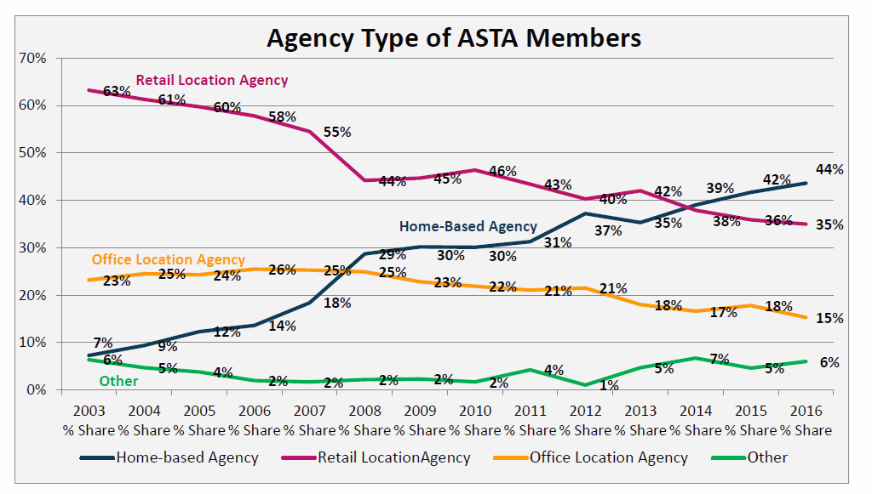
Notes:
Reference - From the agency profile report 2016
In terms of travel agency location types, home-based agencies account for 44% of survey responding agencies, followed by retail location agencies (35%) and office location agencies (15%). The primary reason for the shift of locations is probably cost associated.
Retail location agencies operate at brick-and-mortar store fronts, while office location agencies operate within office buildings or office parks where there are no other retail stores immediately nearby or the general public cannot easily see. Corporate travel agencies (aka TMCs) tend to fall under the latter category.

Slide 15
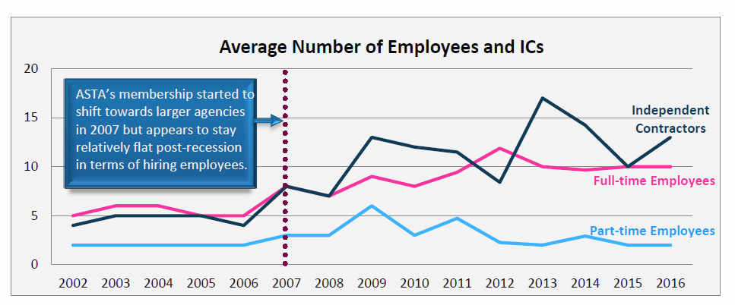
Notes:
Six in ten (59%) of ASTA agencies have employees and/or independent contractors (ICs). The remaining 41 percent are one-person agencies or independent agents.
For those agencies that hire employees or engage ICs, the average number of full-time employees is 10, the average number of part-time employees is 2, and the average number of ICs is 13 in 2016.
The number of full-time employees and ICs are fluctuating compared to each other in recent years. This suggests that agencies are still experimenting with the right mix of employees and ICs.

Slide 16
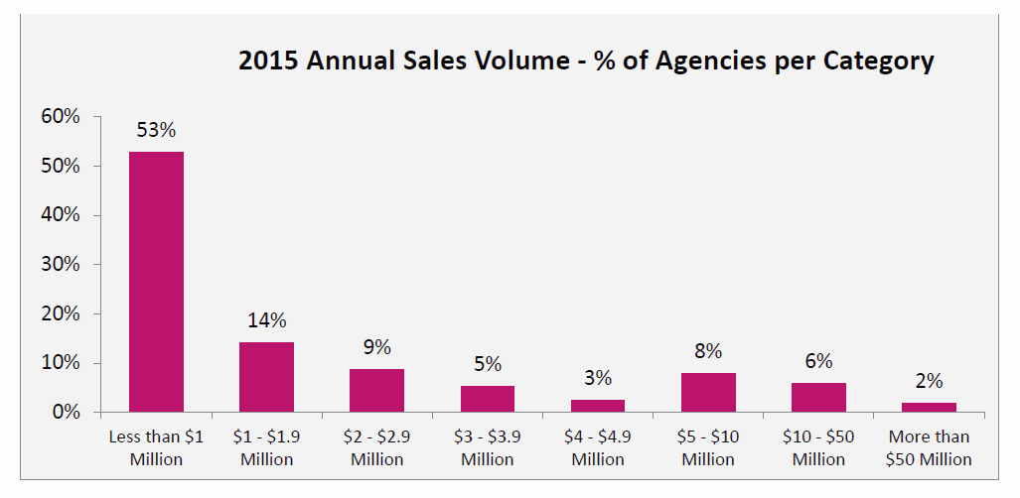
Notes:
One in six (16%) survey responding ASTA member agencies produced more than $5 million in 2015, consistent with industry trends in recent years.
Half of annual survey respondents indicated that they sold less than $1 million in 2015.
Note that survey respondents do not represent the entire ASTA membership and our Premium and CAC agency members typically represent large agencies that are big producers.

Slide 17
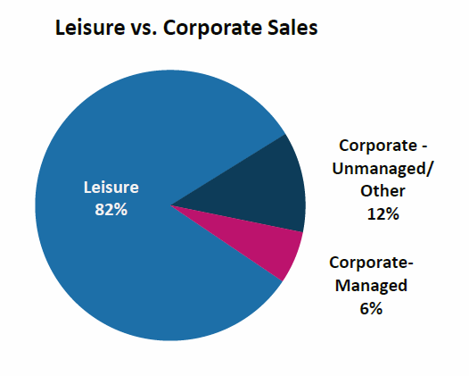
Notes:
ASTA member agencies report that leisure products make up an average of 82% of total sales and corporate sales make up the remaining 18% of sales.
Managed corporate travel makes up 6% of all ASTA member sales, with unmanaged corporate travel and other account for 12%.
Unmanaged corporate travel indicates sales from those companies that currently do not have an official travel program or policy in place for managing employee travel.
Leisure sales are the the most profitable for both the selling travel agent & DMC

Slide 18
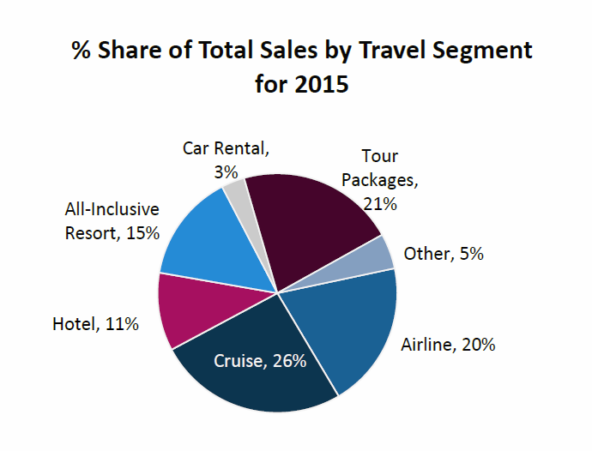
Notes:
ASTA member profile research 2016
When asking ASTA members about their sales mix, tour packages/all-inclusive resorts combined (36%) and cruise (26%) on average represent the largest shares of agencies sales measured in dollars, followed by air (20%).
In 2015, for the first time, ASTA broke out “all-inclusive resorts” into its own category for average sales per category from tour packages/all-inclusive resorts. When broken out, tour packages segment (21%) no longer dominates. It will be interesting to see how this category trends over the next five years.

Slide 19
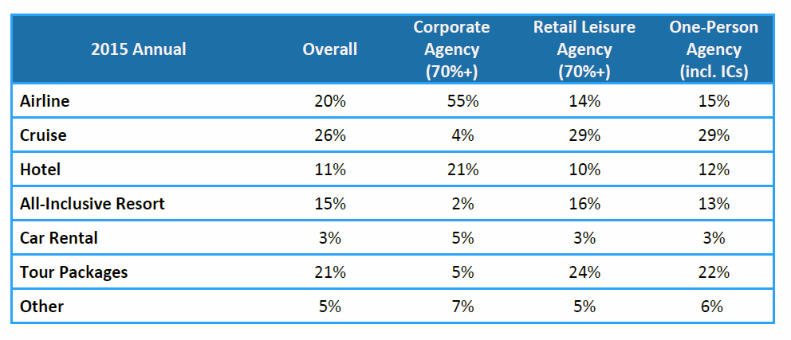
Notes:
Among various business models, the sales mix by segment varies. For corporate agencies (at least 70% of their sales come from corporate/business travel), air travel (55%) still dominates the overall sales volume, followed by hotel (21%).
As for retail leisure agencies, cruise (29%) accounts for nearly one third of sales volume, followed by tour packages (24%).
For one-person agencies (including independent agents), the sales mix is similar to retail leisure agencies with cruise (29%) and tour packages (22%) combined account for over half of the sales on average.

Slide 20
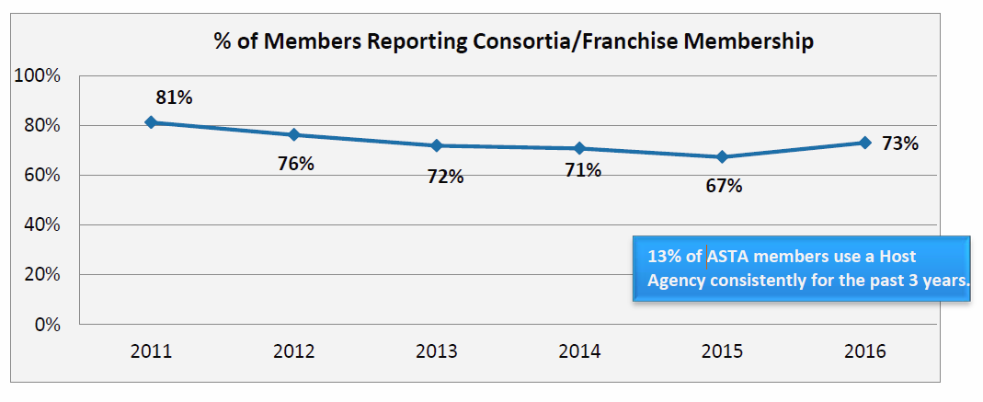
Notes:
The percentage of ASTA agency members with a direct membership in a consortium or franchise appeared to bounce back slightly in 2016. With the support from multiple consortia and franchise partners, ASTA members are reporting a higher percentage of affiliation with a consortium or franchise, thanks to those entities’ new membership programs with ASTA.
Other possible reasons that a higher percentage of ASTA members are affiliated with a consortium or franchise are to obtain collective bargaining power on commission levels, marketing support or sales leads, just to name a few.
Meanwhile, 13% of ASTA members use a host agency, consistent for the past 3 years.

Slide 21
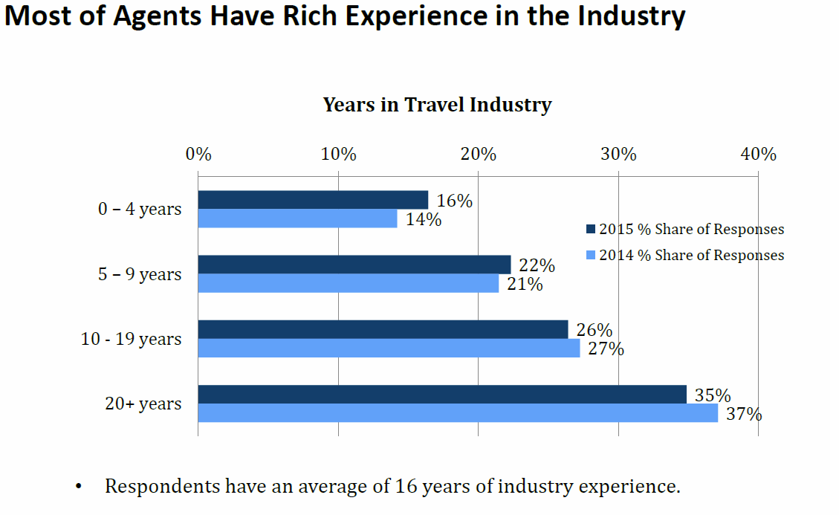
Notes:
On average, NACTA members have 16 years of travel industry experience.
For those members who have 0 to 4 years of experiences, many of typically choose selling travel as their second careers.

Slide 22
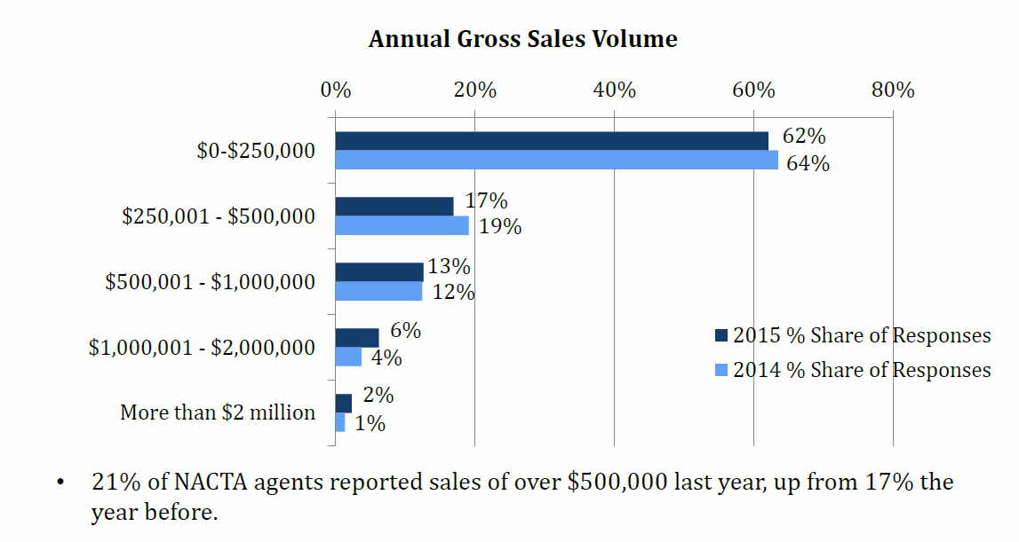
NACTA Agents Represent over $500,000 in Annual Sales
Notes:
One in five (21%) NACTA agents reported sales of over $500,000 last year, up from 17% the year before, showing that NACTA members continue to better themselves in selling travel as a profession.

Slide 23
Top Destinations NACTA Members Sell
Notes:
Speaking of selling specific destinations, in the NACTA member survey our members have indicated that Hawaiian Islands, The Bahamas and Anchorage are the top destinations that they sell travel to among a list of over 20 destinations.
We’re proud to say and show that our members are indeed selling travel to the destinations where NACTA and ASTA have held conferences, showcases and events over the years, and we thank our destination partners, especially Visit Anchorage, to be our host for this year’s NACTA Conference!
US Sales to GREECE is expected to DOUBLE in 2019 with the major result coming from the 2019 ASTA Destination Expo

Slide 24
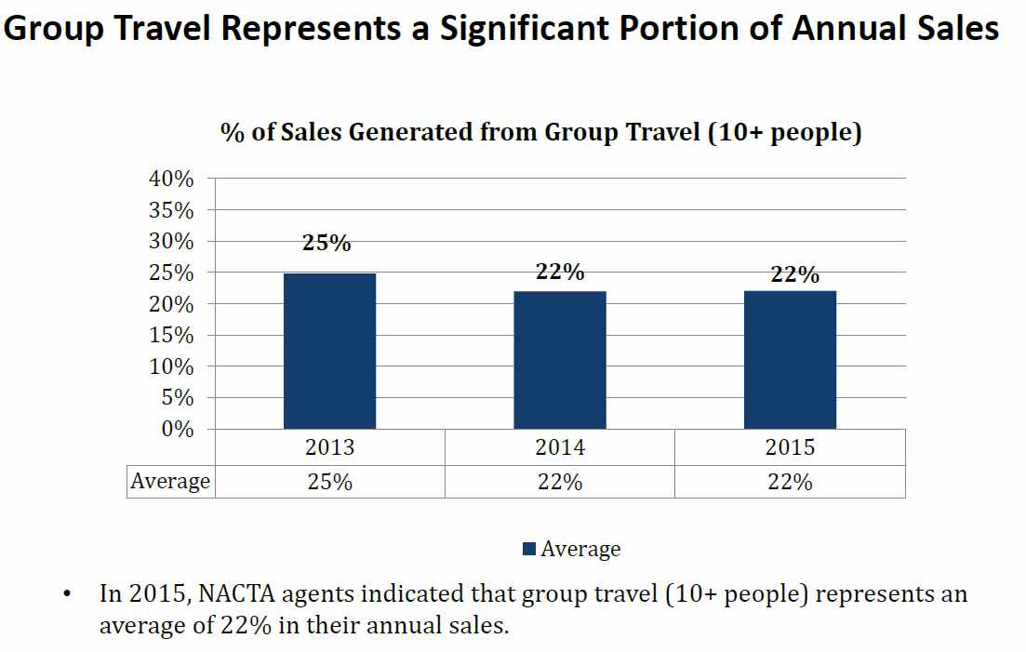
Notes:
NACTA agents indicated that group travel (10+ people) represents an average of 22% in their 2015 annual sales, a big revenue generating category for many NACTA members.
NACTA agents rely on local DMCs for theirdestination expertise

Slide 25
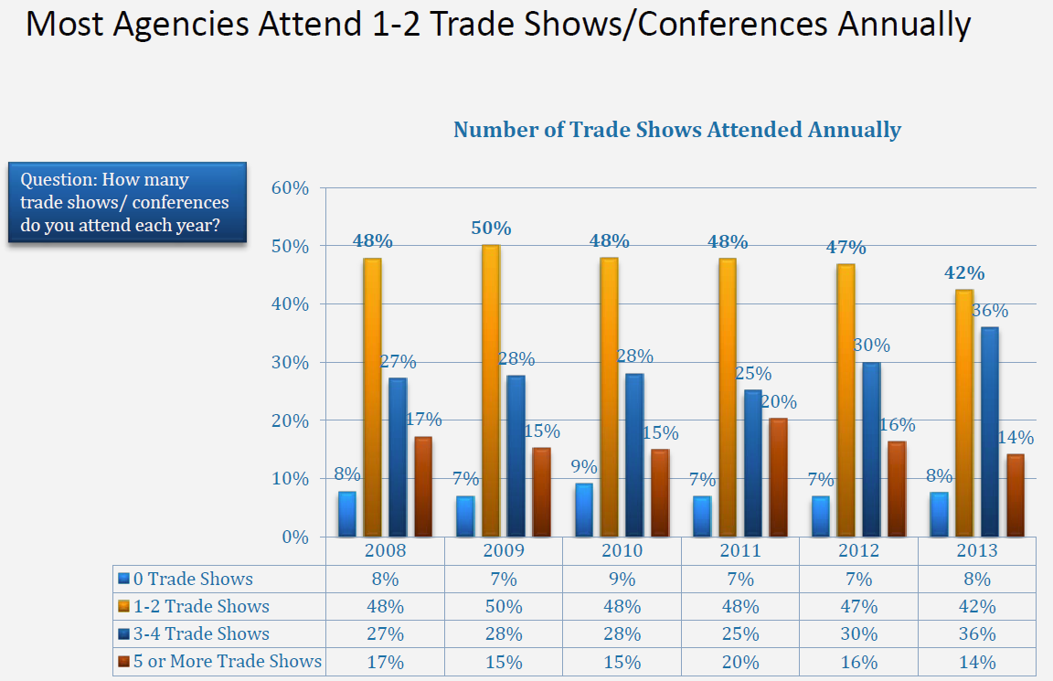
Notes:
Over nine in 10 agencies attended at least one trade show or conference annually.
In 2013, agencies that attended more than 3 trade shows/conferences increased to 50%, the highest level observed over that period.
Most of the increase of attendances came from 1-2 trade shows to 3-4 trade shows.
Attendees ASTA/NACTA international events #1 reason is to meet local DMCs, hotels & tour operators

Slide 26
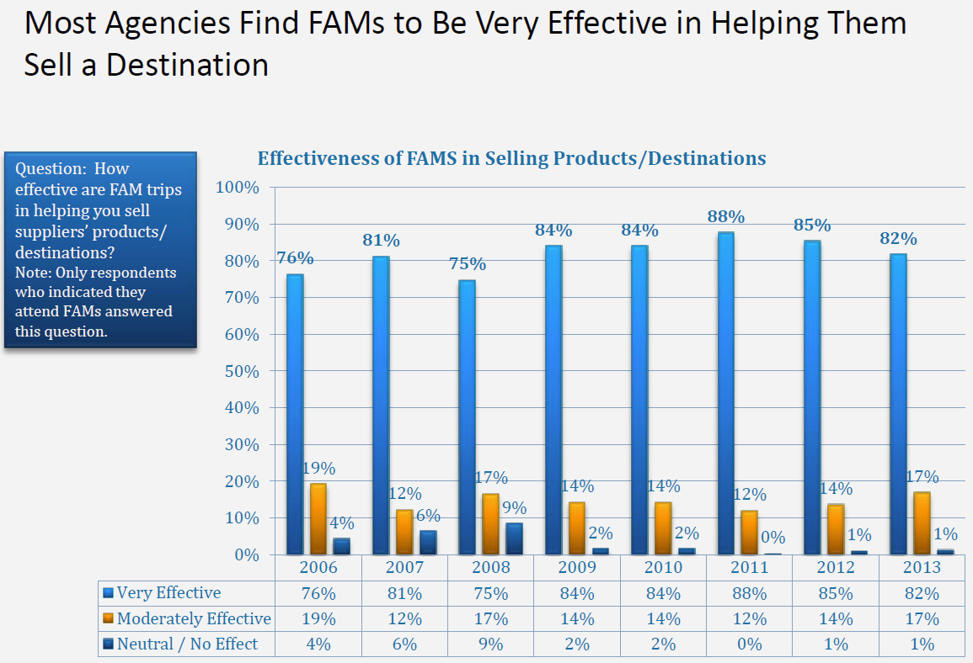
The NACTA FAM we hosted at Explore Fairbanks was one of the best FAMs I have ever had the pleasure of hosting. What a great group! It made me realize more than anything that we, as a DMO, need to be more engaged with NACTA.
- Scott McCrea Director of Tourism
Notes:
Consistently, more than 8 out of 10 agencies indicated that FAM Trips are very effective in helping them to sell a destination.
With the popularity of experiential travel on the rise for consumers in recent years, travel agents that can draw their own first-hand experience from the FAM trips will help them stand out in the crowd in terms of selling specific destinations.

Slide 27
ASTA Education
Travel Advisor Online Education
28 Agency
7 Consortia
8 Supplier
Dues: $2,500 – Agency
$7,500 – Consortia
$10,000 - Supplier
CORE COURSES
Travel Agency Regulatory Compliance
Business Integrity and Ethical Standards
Becoming a Travel Agent
Marketing You
Sales Strategies for the Experienced Travel Advisor
28 Agency
7 Consortia
8 Supplier
28 Agency
7 Consortia
8 Supplier
28 Agency
7 Consortia
8 Supplier
Dues: $2,500 – Agency
$7,500 – Consortia
$10,000 - Supplier
Dues: $2,500 – Agency
$7,500 – Consortia
$10,000 - Supplier
Dues: $2,500 – Agency
$7,500 – Consortia
$10,000 - Supplier
Annual Sales > $50M
Annual Sales > $50M
Annual Sales > $50M
Annual Sales > $50M
Within 18 months, more than 1,200 students have taken the Becoming a Travel Agent course

Slide 28
Introducing

Slide 29
ASTA Educates Travel Agents
28 Agency
7 Consortia
8 Supplier
Dues: $2,500 – Agency
$7,500 – Consortia
$10,000 - Supplier
ASTA Verified Travel Advisor Certification Program
Achieve An Exclusive Level of Trust & Integrity
Gain a Competitive Advantage
Build a Better Business
www.ASTA.org/VTA
28 Agency
7 Consortia
8 Supplier
28 Agency
7 Consortia
8 Supplier
28 Agency
7 Consortia
8 Supplier
Dues: $2,500 – Agency
$7,500 – Consortia
$10,000 - Supplier
Dues: $2,500 – Agency
$7,500 – Consortia
$10,000 - Supplier
Dues: $2,500 – Agency
$7,500 – Consortia
$10,000 - Supplier
Notes:
Introducing
ASTA VERIFIED Travel Advisor Certification Program
The ASTA Verified Travel Advisor (VTA) program is the ASTA standard for excellence. Developed using ASTA’s in-house resources and industry experts, the VTA program is a tool that will allow ASTA members to further enhance their professional development and credibility with consumers, suppliers and even the government. Achieving ASTA VTA certification also means that ASTA has verified your knowledge of the core legal, ethical, regulatory and business framework encompassing consumer travel commerce.
Enroll Today at ASTA.org/VTA
ACHIEVE AN EXCLUSIVE LEVEL OF TRUST & INTEGRITY We know that ethics matter in the travel industry and ASTA holds their agents to a higher ethical standard. Earning the VTA certification is another way to increase traveler trust – to show the consumer that you’ve demonstrated to ASTA your ability to put your customer first.
GAIN A COMPETITIVE ADVANTAGEThe Verified Travel Advisor (VTA) program is an advanced designation earned by the travel professional once they have completed, and passed, the VTA core courses within a twelve-month period. Certain coursework will be required annually thereafter to maintain VTA certification.
BUILD A BETTER BUSINESS The VTA program offers unique industry expertise from ASTA’s experienced team paired with courses from some of most respected educators in the travel business creating one powerful, comprehensive program.
ASTA Members: $399
Non-Member Independent Travel Advisor: $598 (includes ASTA membership for 1 year)
Non-Member Travel Agency: $729 (includes ASTA membership for 1 year)

Slide 30
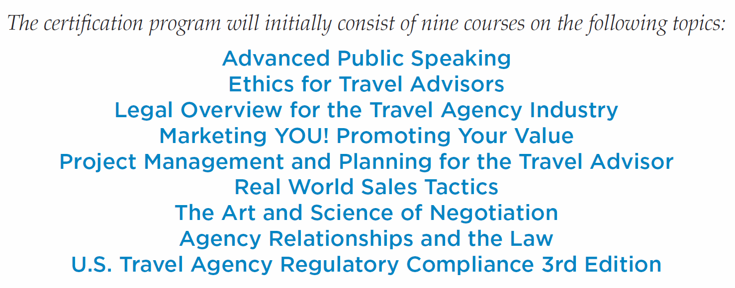
www.ASTA.org/VTA

Slide 31
Connecting Consumer & Advisors
CONSUMERS find Travel Advisors
via Travelsense.org
65,000 unique consumers each month visit ASTAs website
Notes:
Over 100,000 per month – unique visitors
Add the image of travelsence.org

Slide 32
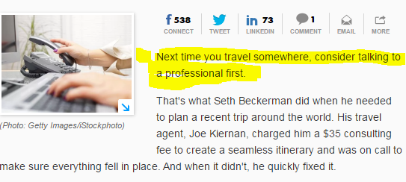
Helping Consumers find Travel Advisors
“The value of a travel agent is immeasurable”
28 Agency
7 Consortia
8 Supplier
Dues: $2,500 – Agency
$7,500 – Consortia
$10,000 - Supplier
28 Agency
7 Consortia
8 Supplier
28 Agency
7 Consortia
8 Supplier
Dues: $2,500 – Agency
$7,500 – Consortia
$10,000 - Supplier
Dues: $2,500 – Agency
$7,500 – Consortia
$10,000 - Supplier
28 Agency
7 Consortia
8 Supplier
Dues: $2,500 – Agency
$7,500 – Consortia
$10,000 - Supplier
Annual Sales > $50M
Annual Sales > $50M
Annual Sales > $50M
Chris Elliott weekly columnist for USA Today and the Washington Post. Also a nationally syndicated columnist contributor to contribute National Geographic, NPR, Smithsonian and Travel & Leisure

Slide 33
Notes:
We continue to insert ourselves into the mainstream media, letting the world know that we exist and how we exceed consumer expectations by transforming the way the world travels.
AARP
Forbes
The Boston Globe
CNN
This has been a #1 priority for our members, and we are fulfilling that promise to advocate for travel agents through our consumer awareness campaign. We’ve hired a world renowned PR firm our CPs have invested and funded portions of this initiative. (Bursen Marstellar.) Listeners should stay tuned because in May we will doing a media tour in NY to celebrate a national travel and tourism week.
Look for the other PPT with more logos – lots and lots
Image of the

Slide 34
Notes:
We continue to insert ourselves into the mainstream media, letting the world know that we exist and how we exceed consumer expectations by transforming the way the world travels.
AARP
Forbes
The Boston Globe
CNN
This has been a #1 priority for our members, and we are fulfilling that promise to advocate for travel agents through our consumer awareness campaign. We’ve hired a world renowned PR firm our CPs have invested and funded portions of this initiative. (Bursen Marstellar.) Listeners should stay tuned because in May we will doing a media tour in NY to celebrate a national travel and tourism week.
Look for the other PPT with more logos – lots and lots
Image of the

Slide 35
Industry Partnership
28 Agency
7 Consortia
8 Supplier
Dues: $2,500 – Agency
$7,500 – Consortia
$10,000 - Supplier
28 Agency
7 Consortia
8 Supplier
28 Agency
7 Consortia
8 Supplier
28 Agency
7 Consortia
8 Supplier
Dues: $2,500 – Agency
$7,500 – Consortia
$10,000 - Supplier
Dues: $2,500 – Agency
$7,500 – Consortia
$10,000 - Supplier
Dues: $2,500 – Agency
$7,500 – Consortia
$10,000 - Supplier
Consortia/
Franchise/Hosts
Sells and Marketing
Business Tools
Supplier Relationships
Business Panning
Annual Sales > $50M
Annual Sales > $50M
Annual Sales > $50M
Annual Sales > $50M
Connecting travelers with travel advisors
Industry-Wide Networking
Industry Intelligence
Advocacy
Community
Education
Notes:
Supporting the agency

Slide 36
Consortia Partnerships

Slide 37
Host Agencies
Notes:
Host agency list
fix the logo

Slide 38
Nerve Center of the Industry
Notes:
Make the TMC - Hosts

Slide 39
ASTA Organization
Corporate Advisory Council
28 Agency
7 Consortia
9 Supplier
Annual Sales > $50 Million
Premium Travel Agencies
Travel Agencies
Independents
Travel Suppliers
147 Companies
3,952 Employees
$5 Million to $50 Million
1,889 Companies
3,178 Employees
Up to $5 Million
533 Individual Agents
Affiliated with ASTA Agency Member/Active NACTA Member
1,022 Companies
1,281 Employees
100+ Countries
Dues: $599
Provide products, services & information to agencies
Notes:
Showing the different levels
Remove the dues amounts other than supplier

Slide 40
ASTA Advocacy
Representing the agency community with -
All Levels of Government
Travel Suppliers
Technology Players
Consumers
Direct Lobbying
Grassroots Lobbying
Political Engagement
Air, Car, Hotel, Cruise, Rail, Insurance, etc.
GDS, Aggregators, etc.
TravelSense.org
Consumer Research
Bottom Line: ASTA is the only organization with the industry expertise and relationships, with policymakers, coalitions and the industry to meet this mission
Notes:
Delete slide – maybe – keep until Ann review slide deck

Slide 41
ASTA is Expanding
Inclusive Association
32 Chapters and Climbing
New Area Directors
Growing Membership
Vibrant Management Team
650 Independent Agents
Independent Consultants Fastest growth segment of the agent industry
Notes:
The NEW ASTA
Who is the new ASTA,
New ASTA- Inclusive Association
Stronger chapters
No elections
New membership team
Area directors
Growing – Today the largest growth is in IC… daily – fastest growth segment of the business
We currently we have over 400 IC members in ASTA. $199 rate is open to all ICs of all ASTA agency members.

Slide 42
Travel Agents join ASTA & NACTA to:
Prove credibility and trust with ASTA & NACTA’s logo
Access critical industry documents to protect their business
Access new consumers /TravelSense.org
Connect with suppliers and boutique operators (fedHATTA)
Grow their client base with real time consumer prospects
Broaden their network and strengthen business acumen
Notes:
When you join ASTA, you join to: (Slide 1 )
Prove your credibility and trust with ASTA’s logo
Access critical industry documents to protect your business
Help consumers find you/TravelSense.org
Protect our industry and speak with ONE VOICE
Grow your client base with real time consumer prospects
Broaden your network and strengthen your business acumen
Add a photo an agent

Slide 43
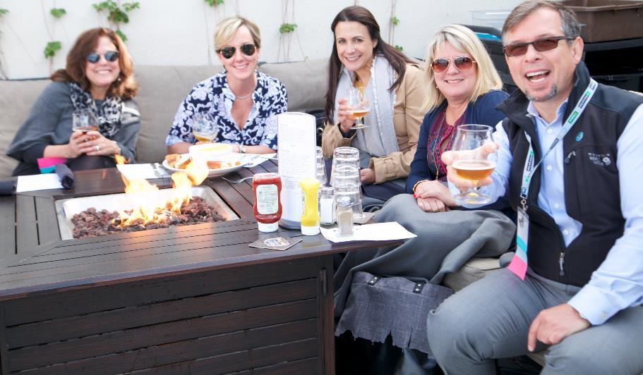
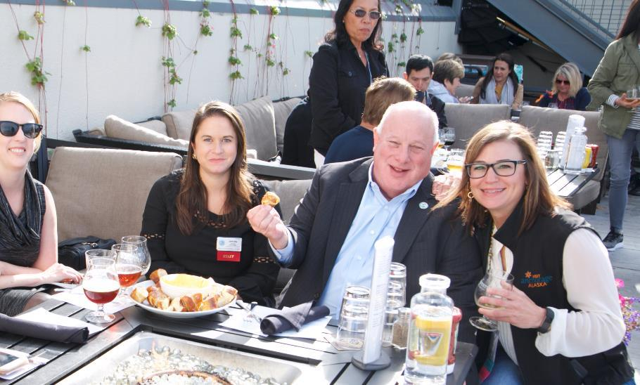
How to Network Better
Join and be recognized
Attend Conferences
Invest in Sponsorship
Invite to Alaska
Notes:
How you benefit is building your database of travel sellers, connecting with group promoter, and creating contacts. ASTA and NACTA provide this engage between travel supplier and agents

Slide 44
SAN DIEGO 1,000
ASTA Global Convention Aug 26-29, 2017
Washington D.C.
ASTA Global Convention
Aug 21-24, 2018
Notes:
In June (4-7) will be hosting our Capitol Summit in Washington D.C. The first half of the meeting will be for ASTA’s Premium members, followed be a full day of advocacy on Capitol Hill where we’ll speak as one voice to represent all agents and influence legislators.
$100 off – code is HOMETOWN
Added and just completed stamp mark – graphic to the san diego

Slide 45
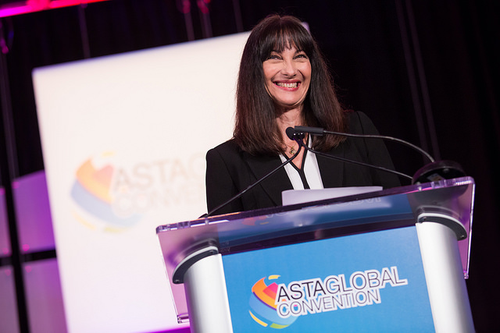
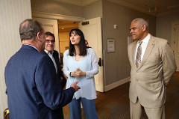
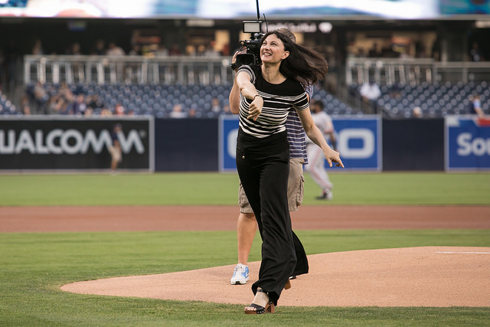
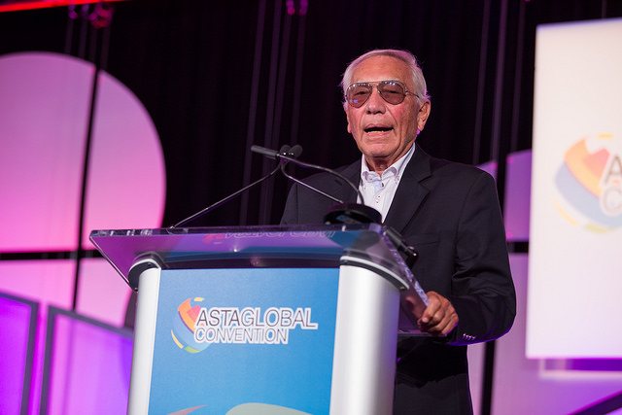

Slide 46
ALASKA
NACTA Annual Conference
Sept 13-16, 2017
300 attendees
Washington DC
NACTA Annual Conference & 7-day Cruise
Aug 23-26, 2018
Notes:
ASTA/NACTA Bahamas Showcase June 21-24, experience a new side of Nassau.
NACTA Annual Conference
Sept 13-16
ASTA members are welcome Denali 3-days, Prince William Sound, Alaskan Dream Cruises 4 day Sitka- Juneau.
Graphics, just completed
Add the new logo and add / new images

Slide 47
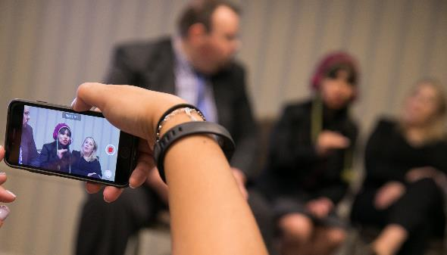
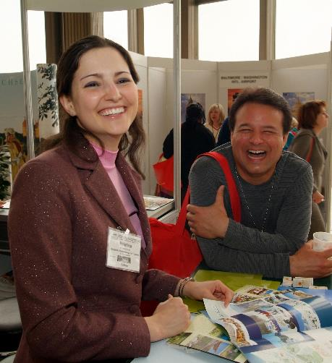
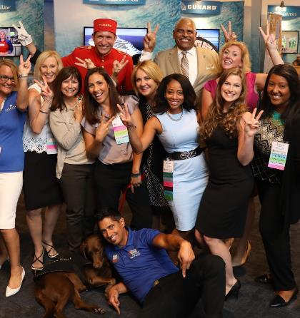
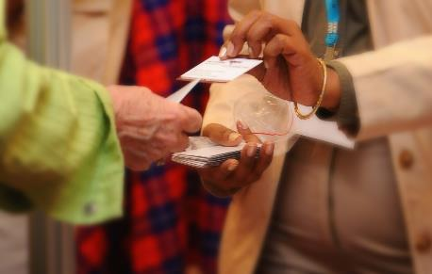
Face to Face Time with Travel Advisors ASTA/NACTA Events 2018: ASTA Showcase – Fairbanks Alaska | Feb 18–22 ASTA Premium Business Summit – Washington, DC | March 4-5 ASTA Legislative Day – Washington, DC | May 7–8 ASTA Destination Expo – Athens, Greece | Apr 14–17 ASTA Global Convention 2018 – Washington, DC | Aug 21–23 NACTA Conference–Washington, DC & Cruise | Aug 23–26
Notes:
I want to share with you how this conference came to be ….sitting one night sitting at my table with my friend Michael who connected to me with David Kasser.
! Ann, personal experience in this industry – my story, love this destinations, all the connections I have… my membership wants to know you

Slide 48
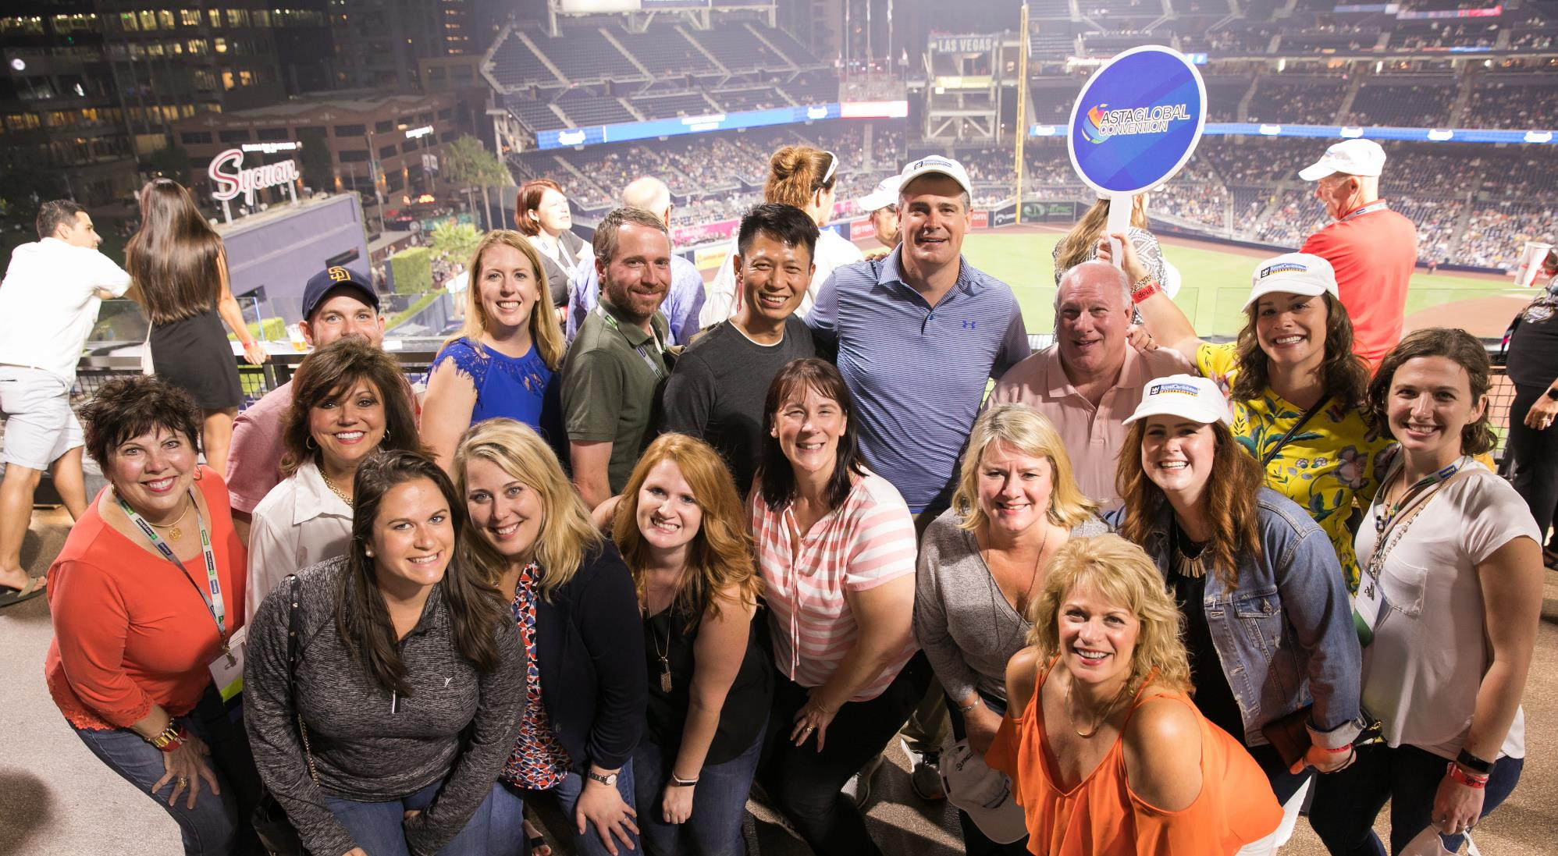
THANK YOU! Connecting you with ASTA & NACTA Travel Advisors

Slide 49
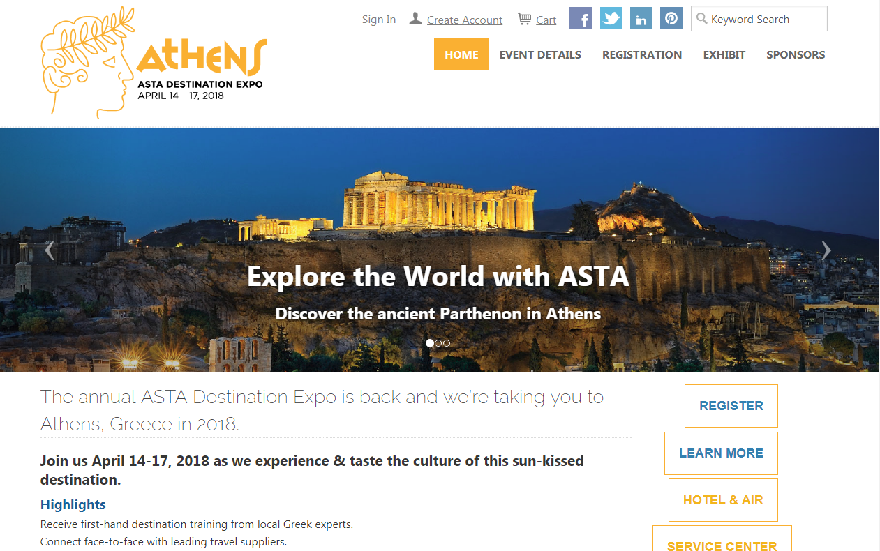
Registration Steps
www.ASTA.org/Athens

Slide 50
Registration Steps:
Search your First, Last, and Email Address
If your profile pops up select the button the left, otherwise, select New Registration
Fill out the form with your appropriate information
Select “Travel Supplier/Tour Operator/DMC” button
Complete remainder of form
Select Supplier Package and add-ons
If paying by wire transfer enter Discount Code WIRETRANSFER
Enter Payment information
Click the I agree checkbox
Complete Registration

Slide 51
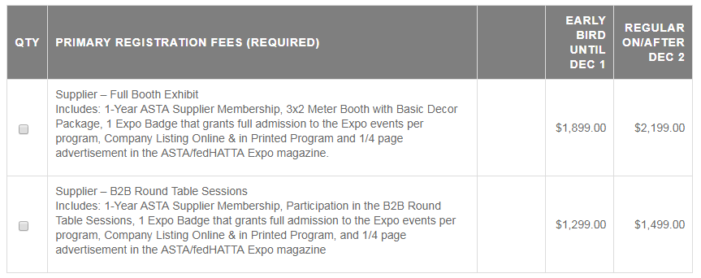
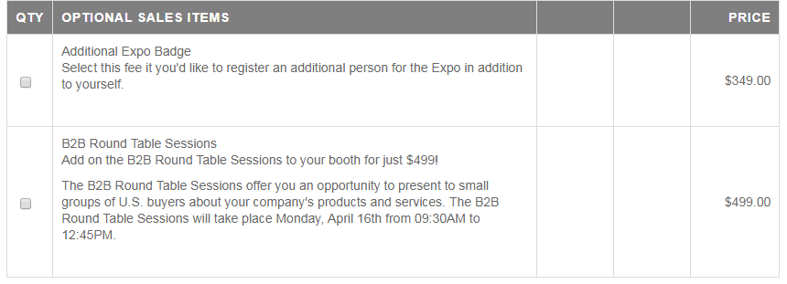
Registration Options for Suppliers

Slide 52
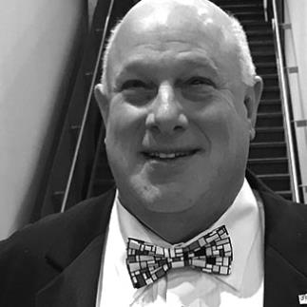
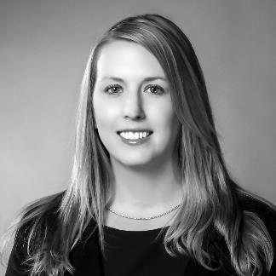
ASTA Athens Destination Expo Team
Bob Duglin
Vice President
bob@asta.org
Karen Morris Director Meetings & Events
karen@asta.org
Kelly Bigel
Director Business Development
kelly@asta.org
Sarah Little
Director Business Development
sarah@asta.org
Don McGahee
Manager FAM Programs
bob@asta.org

Slide 53
Bob Duglin
bob@asta.org 703.739.6829
ευχαριστώ
Ask me
Notes:
All small supplier who want to know about ASTA – this is a work shop about doing businesses in the travel agent channel
101 for travel supplier
Workshop
How to get your product sold by a professional travel advisor
Expanding your sell force

